Slide 1
Unchain your app’s capabilities with Microsoft Graph
Yannick Plenevaux
yp_code

Slide 2




Yannick Plenevaux
SharePoint & Office 365 Architect
MCSD App Builder
@ yannick.plenevaux@pvx-solutions.com
@yp_code
https://ypcode.wordpress.com
Founder of PVX Solutions
https://www.pvx-solutions.com

Slide 3
Agenda
Corporate data
The Microsoft Graph API
The Graph Explorer
Security
Permissions
Authorization Flow
Create your app !
Microsoft Graph in SPFx solutions
Q&A

Slide 4












Corporate data
Activities
Devices
Tasks
People
Organization
Conversations / Chats
Me
Events
Documents
E-mails
Content
Groups

Slide 5





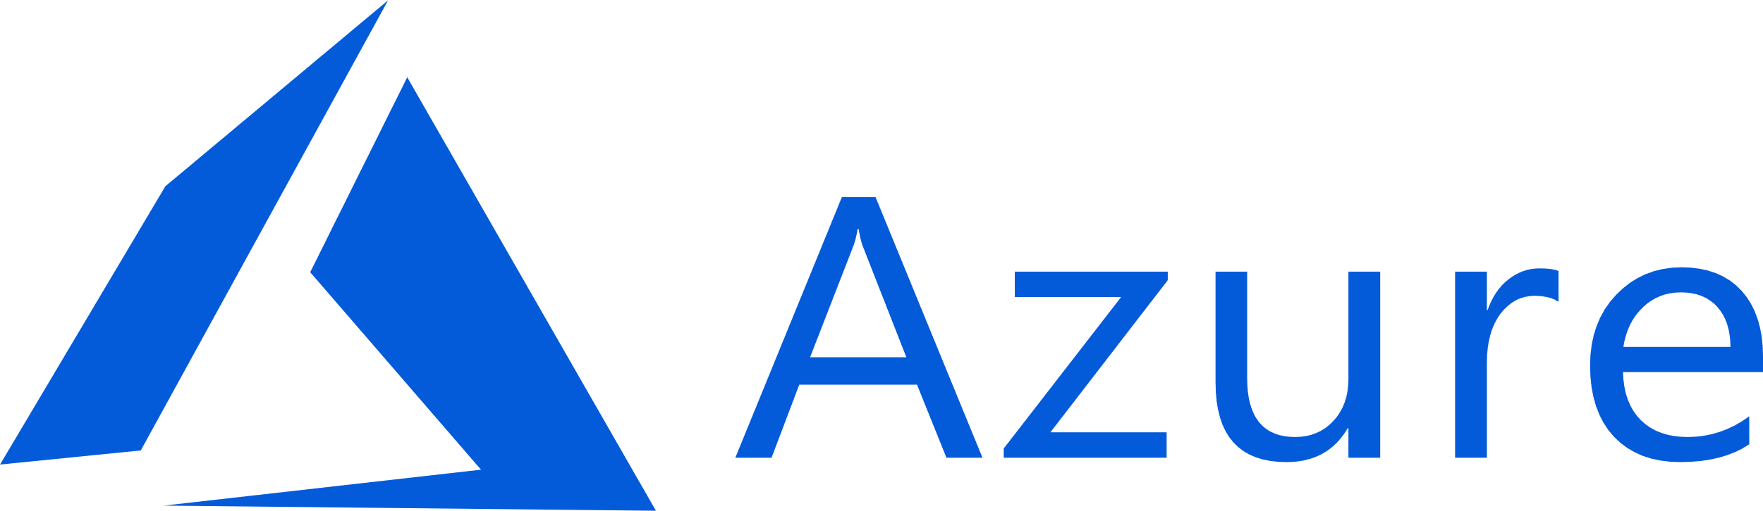







Microsoft 365 data
Activities
Devices
Tasks
People
Organization
Conversations / Chats
Me
Events
Documents
E-mails
Content
Groups

Slide 6
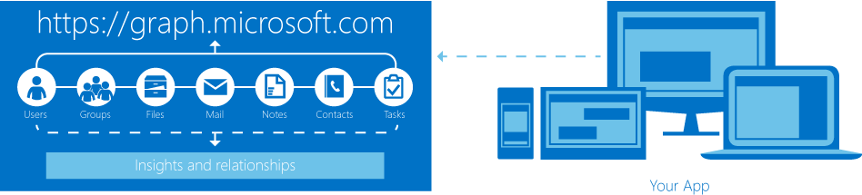
The Microsoft Graph API
One API to access and manipulate all corporate data in your app !
V1.0 : Stable and fully supported by Microsoft for Production usage
Beta : Preview of upcoming capabilities. → Subject to changes → Not supported by Microsoft for Production usage

Slide 7
The Microsoft Graph API
Only on Microsoft 365 / Office 365 (Cloud)
Will most likely never come fully on premises !
Why ?
It continuously evolves (release each month)
It uses a lot of machine learning algorithms on interconnected data from various Microsoft services
➔ Would be very difficult to setup and maintain…
It is THE Microsoft Cloud “killer app” ☺ !
However, some hybrid scenarios are feasible
Announced at Build 2019 : Include your local Data in Microsoft Graph

Slide 8
The Microsoft Graph API
https://graph.microsoft.com
RESTful = HTTP calls
Read → HTTP GET
Create → HTTP POST
Update → HTTP PUT / PATCH
Delete → HTTP DELETE
Implements OData syntax in most cases
$filter
$select
$skip / $top
$expand
$orderby
…
Get my 3 next events GET https://graph.microsoft.com/v1.0/me/events?$filter=start/dateTime gt ‘2019-05-16T00:00:00’&$orderby=start/dateTime asc&$top=3
Get the files in my OneDrive folder GET https://graph.microsoft.com/v1.0/me/drive/root/children

Slide 9
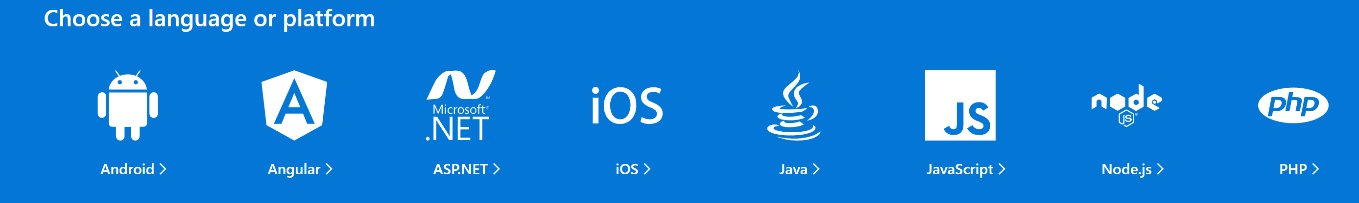
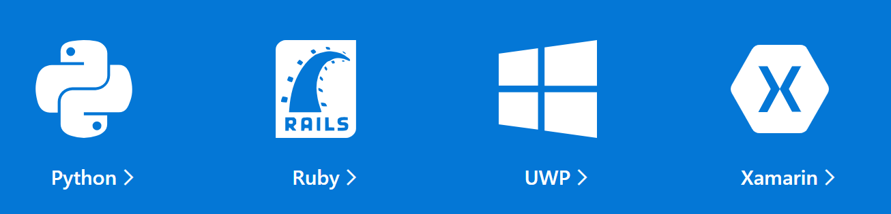
The Microsoft Graph API
Accepts JSON as arguments and return JSON responses
➔ Can be used in any technology with HTTP capabilities
API client implementation in various technologies
https://developer.microsoft.com/en-us/graph/get-started

Slide 10
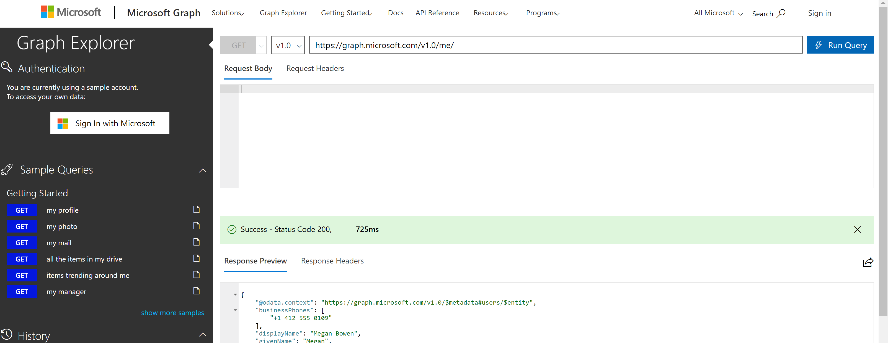
The Graph Explorer
Test the Microsoft Graph API
In a playground context (read-only)
With your tenant real data
https://developer.microsoft.com/en-us/graph/graph-explorer

Slide 11
The Graph Explorer
DEMO

Slide 12




Security: Permissions
Permissions have to be granted to the application
Delegated permissions → The application performs the actions on behalf of a signed-in user. → “Effective permission” is the least privileged permission between the delegated permission and the real privilege of the user
Application permissions (app-only) → Not signed-in user (background job, automated tasks, …)
Consent has to be given to the application
Delegated permissions → The current user gives consent to the requested permissions → Administrators can give consent for all users → Some permissions require an administrator to give consent
Application permissions → Only administrators can give consent
https://docs.microsoft.com/en-us/graph/permissions-reference

Slide 13
Security: Authorization flows
Azure AD protected Web API
The authorization endpoints :
https://login.microsoftonline.com/common/oauth2/v2.0
/authorize (Sign-in)
/token (Get access token)
Pass the access token in each Graph HTTP call headers Authorization: Bearer <access token>
Authorization Flow | Common usage
OpenID Connect | Web applications
OAuth 2.0 Implicit Grant | Client-side applications (JS)
OAuth 2.0 Auth Code | Native (Desktop, Mobile) applications
OAuth 2.0 on-behalf-of | Web APIs
OAuth 2.0 Client Credentials | App-only (Background jobs, …)
…
common can be replaced by the tenant id to target a specific tenant (e.g. contoso.onmicrosoft.com)
These authorization flows are mostly handled by the available client APIs !
If not, it can be implemented in any technology with HTTP capabilities

Slide 14
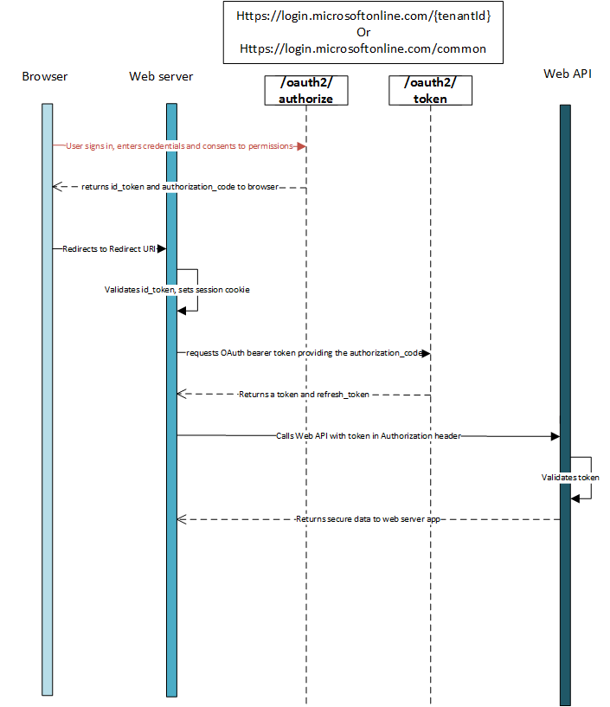
Authorization flow Web app
Microsoft Graph
Data from API forwarded to user

Slide 15
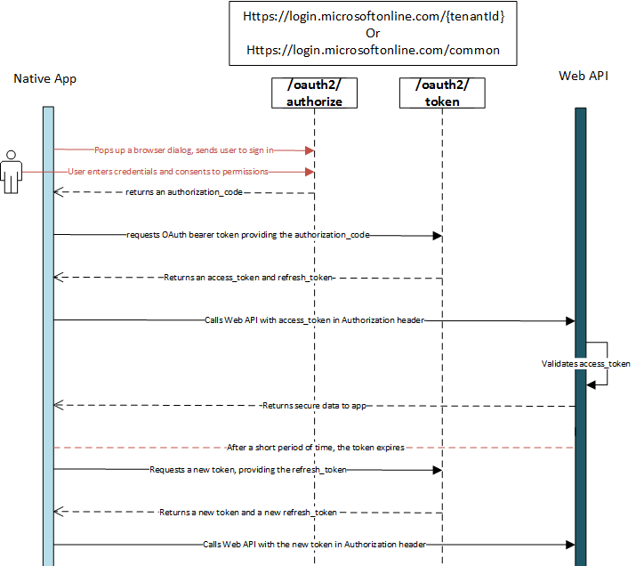
Authorization flow Mobile/Desktop app
Microsoft Graph
Access Token expires
after 1 hour
1 hour
Refresh token expires
after 14 days
renewable up to total 90 days

Slide 16
Create your app !
In order to access graph from an application
Setup (by Azure AD administrator)
Need to register the app in Azure AD → https://aad.portal.azure.com ➔ App registrations
For Web applications ➔ Need Redirect URI
Need to request the appropriate permissions for the app to work properly
At runtime
The user signs in
At first sign-in, the user must give consent to the permissions requested by the application
Administrators can give consent for all users (can also be done from AAD portal)
No “sign-in” in app-only context
Get Access Token
Call the Microsoft Graph endpoint with the Authorization header set to Bearer <access_token>

Slide 17
Create your app !
DEMO

Slide 18
Microsoft Graph in SPFx solutions
SPFx v1.6 (Aug. 2018)
Call to AAD registered app natively supported
Dedicated feature support for Microsoft Graph
As in any app using MS Graph
The appropriate permissions needs to be requested
The permissions must be granted by a SharePoint global administrator
→ No need to access Azure AD portal
SPFx integrated library to automatically handle the access token internal plumbing

Slide 19
Microsoft Graph in SPFx solutions
DEMO

Slide 20
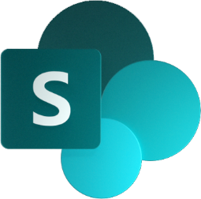
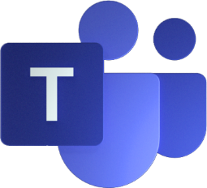
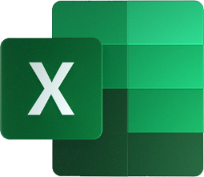
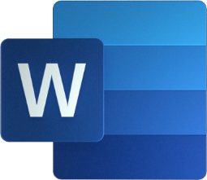
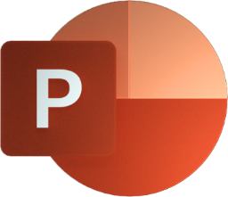

Microsoft Graph in SPFx solutions
Leverage your corporate data using Microsoft Graph
In your SharePoint customizations
In your custom Microsoft Teams Tabs
Soon in your Office add-ins ! ( Word, Excel, PowerPoint, Outlook)
Public announcements are expected at SPC this month !
Using ONE Framework and even ONE codebase

Slide 21
Unchain your app’s capabilities with Microsoft Graph
Questions ?

Slide 22




